Slide 1


Slide 2
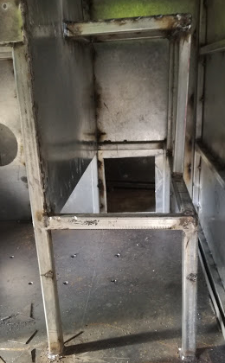
FRAME MEMBERS ISSUES
The width of the frames for the tablet mounting are not uniform all the way to the bottom (Measures 500mm at the top and narrows down to 495mm).
The flow meter mounting frame is not at a 90 degree angle (see photo).
The cross member at the bottom was not welded as per the drawing therefore it falls at the same position as the hose reel mounting holes.

Slide 3
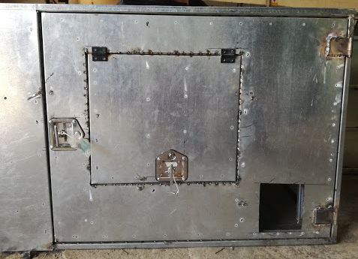
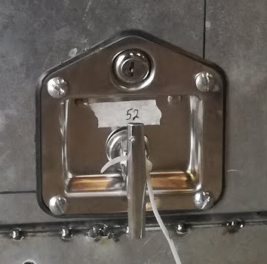
DOOR ISSUES
The size of the back door panel is not per the drawing (Drawing size = 1152*885; Actual size = 1127*885).
ALL the doors are still misaligned thus leaving uneven gaps within the door frame. (see photo)
The door brace cavities have breaks on them to provide spaces for the protruding door lock fasteners. These breaks/notches need to be uniform in size and the rubber lining should be neatly placed around them.
The heads of the screws used at the door locks are already worn off a bit as seen in the second image.
Uneven gaps

Slide 4
ANTENNAE CUT OUT
The diameter of the antennae cut out should be 20 mm and not 24 mm.

Slide 5
TABLET MOUNTING
The mounting holes for the tablet have been drilled incorrectly on the frame members therefore misaligning with the actual tablet bracket.

